Slide 1
Graph Theory
Presented By: Ruman Waris
Ag# 2019-ag-6082

Slide 2
Degree Distribution
Degree distribution is defined as:
“Probability that a randomly selected node has a degree ‘k’.”

Slide 3
Degree Distribution
Formula:
Where,
P_{k} = Degree distribution
N_{k} = selected node
N = Total number of nodes
P_{k} = N_{k} / N

Slide 4

Degree distribution
The sum of all the probabilities of selected nodes will be = 1
$$\sum_{i=1}^{∞}{Pk}=1$$

Slide 5
Example
Consider a connected graph
2
3
1
4

Slide 6

Example
There are 4 nodes in the graph as mentioned
Probability that the selected node has degree ‘1’
The Node ‘1’ has the degree 1
Using Formula:
P_{k}$=\frac{Nk}{N}$
P₁ = ¼ = 0.25
2
1

Slide 7
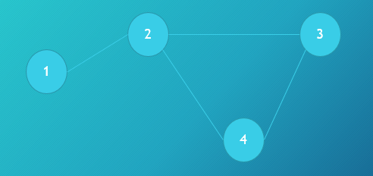
Example
Probability that selected node has degree ‘2’.
As you can see in the node ‘3’ and node 4 has
degree of nodes = 2
Using Formula:
P₂ = ²/₄ = 0.5

Slide 8
Example:
Probability that selected node has degree ‘3’.
Node 2 has the degree of vertex = 3 (max. for this graph).
Using Formula:
P₃ = ¼ = 0.25

Slide 9

Example
P₁ + P₂ + P₃ = P_{k} ( Avg. Degree Distribution)
0.25 + 0.5 + 0.25 = 1
Proved that:
$$\sum_{i=1}^{∞}{Pk}=1$$

Slide 10
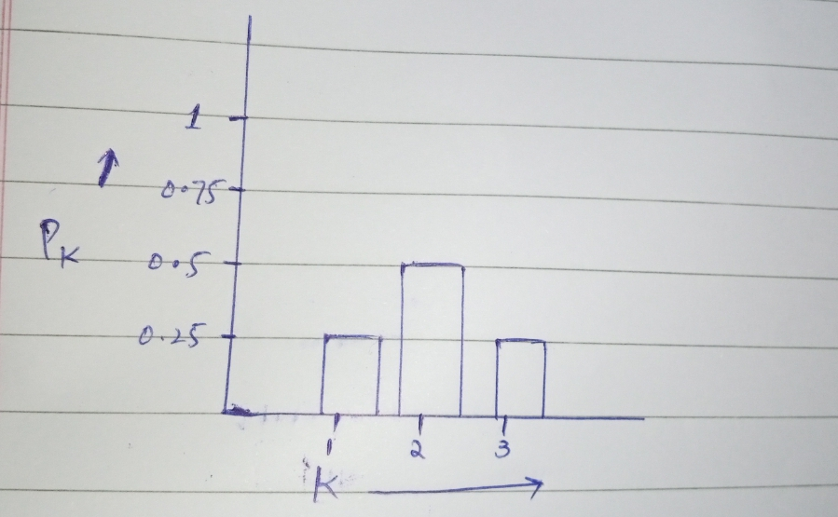
Histogram

Slide 11
Preferential Attachment
“Preferential attachment is a concept in network theory that describes the phenomenon whereby nodes with more connections are more likely to attract additional connections. This can lead to the formation of "hubs," or highly connected nodes, within a network.”

Slide 12
Preferential Attachment (Cont.)
New nodes prefer to attach with well connected nodes over less well connected nodes.
It means, the degree of well connected nodes gets more higher.
In such case the there will be some nodes with the highest and some with lowest degree.

Slide 13
Preferential Attachment (Cont.)
Phenomenon used in Economics as well.
Preferential attachment is also known as:
Cumulative Advantage
Rich gets rich
Mattew effect

Slide 14
Preferential Attachment in Networks
Studied Price in 1965
Model:
Proposed to get the probability that a paper has K no. of citations.
Model was based on Power Law Distribution:
α = 2+1/m
M is the mean citation

Slide 15
Preferential Attachment in Networks
Degree probability:
P(k)= 1/k^{2+1/m}
Where,
2+1/m = α
But that model was proposed for general citation perspective.

Slide 16
Example
D
A
C
E
F
B

Slide 17
Example
As described earlier,
The Node ‘B’ has 2 edges.
It will get connected with the highly well-connected nodes (Nodes with more no. of edges).

Slide 18
More about Preferential Attachment
The preferential attachment model is a simple mathematical model that describes how the growth of a network can lead to preferential attachment.
It is based on the idea that the probability of a new element (such as a new individual in a social network) connecting to an existing element (such as an existing individual in a social network) is proportional to the number of connections that the existing element already has.

Slide 19
Real World Example
For example,
In a social network, a person with a large number of friends is more likely to attract new friends than a person with fewer friends. This can lead to a positive feedback loop, where popular individuals or groups continue to accumulate more connections, while less popular individuals or groups struggle to gain new connections

Slide 20
Application
Preferential attachment has been used to explain a wide range of phenomena,
Including the evolution of language,
The distribution of wealth and income,
The growth of scientific citations.
It is an important concept in the study of complex systems and networks.

